Slide 1
Retail / E-commerce Performance Analysis
Sales, Profitability, and Discount Impact (2014–2017)
Analyst: Tony Deehan
Portfolio Project | March 2026

Slide 2
Business Problem
Sales performance has been growing over time, but profitability does not always follow the same trend.
Discounting is widely used across product categories, but its impact on profit margins is unclear.
Different product categories may perform differently in terms of revenue and profitability.
The business needs to understand how sales, profit, and discounting interact to make better decisions.

Slide 3
Dataset Overview & Structure
Dataset: Superstore retail dataset (2014–2017)
Contains transactional sales data across multiple product categories
Each row represents a single customer order
Used to analyse sales performance, profitability, and discounting behaviour
*Note: Analysis focuses on revenue and profit metrics; marketing cost data is not included.
Key Fields:
Sales – total revenue per order
Profit – profit per order after costs
Profit Margin – profit as a percentage of sales
Discount – percentage reduction applied to the order
Category – product category (Furniture, Office Supplies, Technology)
Order Date – used for time-based analysis

Slide 4
Key Business Questions
How have sales and profit trended over time?
Are increases in sales translating into higher profitability?
How does discounting impact profit margins?
Which product categories perform best in terms of revenue and profit?
Are certain categories more reliant on discounting than others?

Slide 5
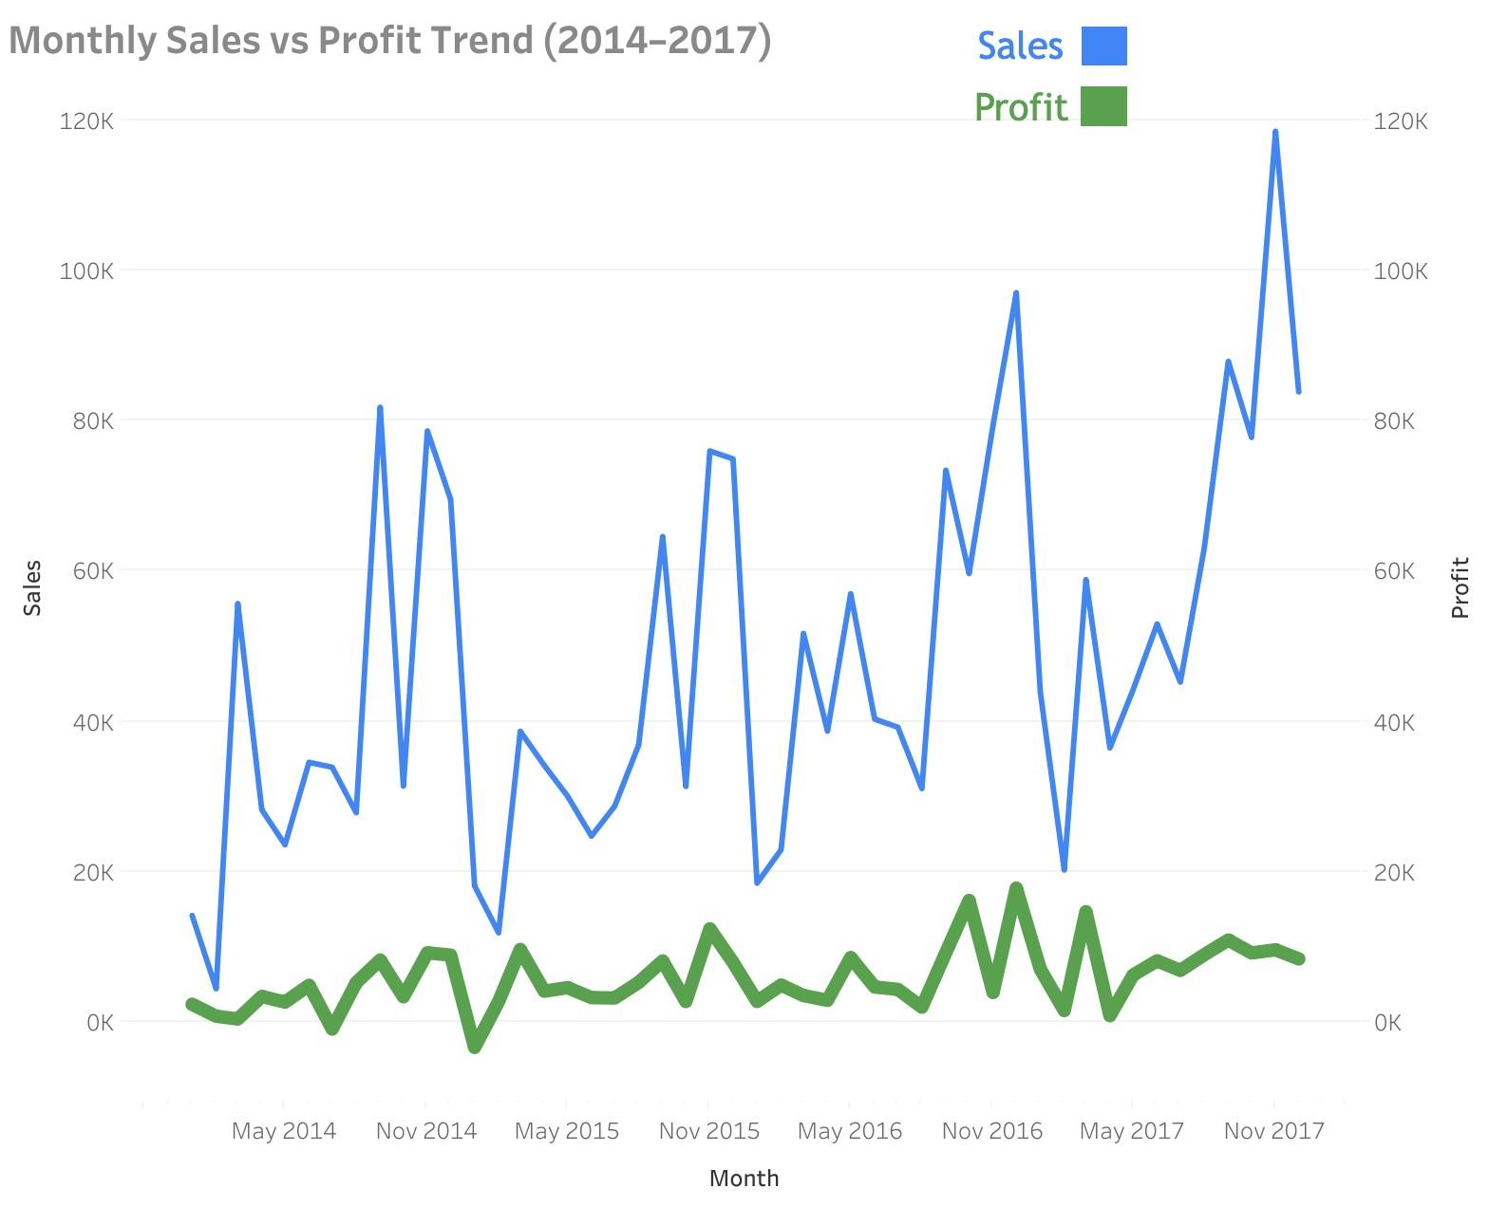
Sales vs Profit Trend Over Time
Sales show a clear upward trend over time
Profit is more volatile and does not consistently follow sales growth
Periods of high sales do not always correspond to high profitability
This suggests underlying factors (such as discounting) impacting margins

Slide 6
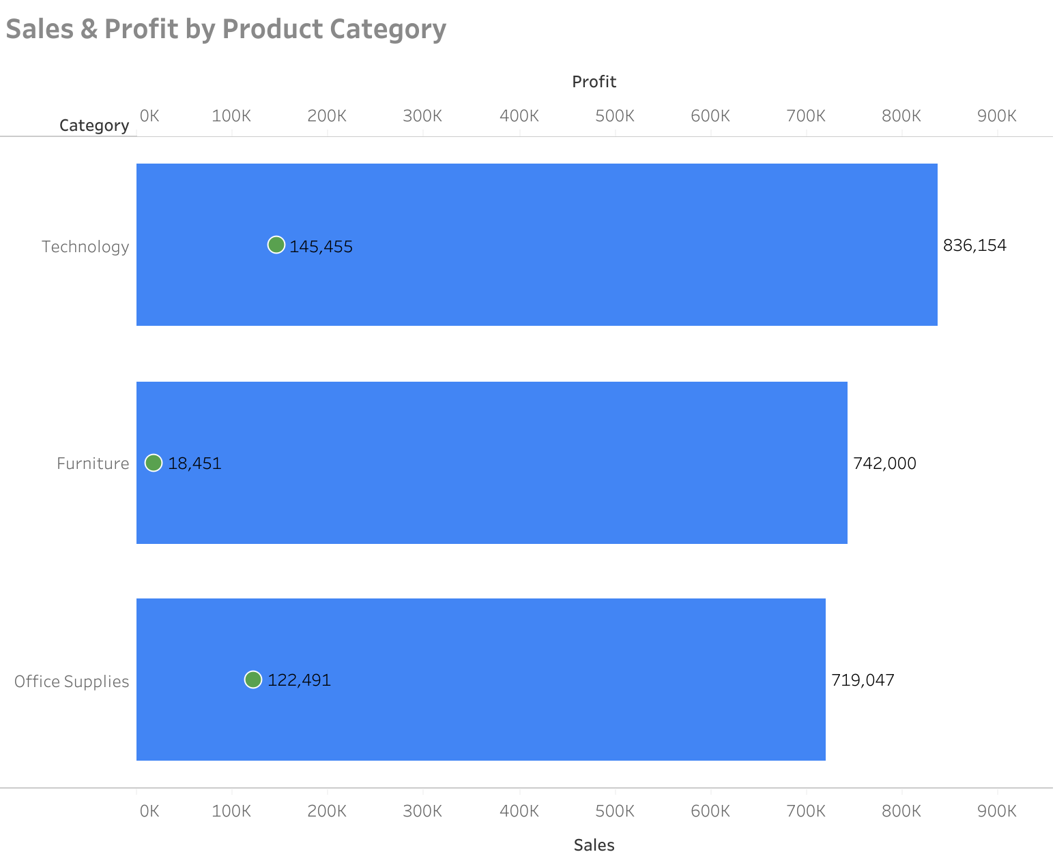
Sales & Profit by Product Category
Technology generates the highest sales and profit
Office Supplies performs strongly in profit relative to its sales
Furniture generates high sales but significantly lower profit
This suggests profitability varies across categories, not just revenue

Slide 7
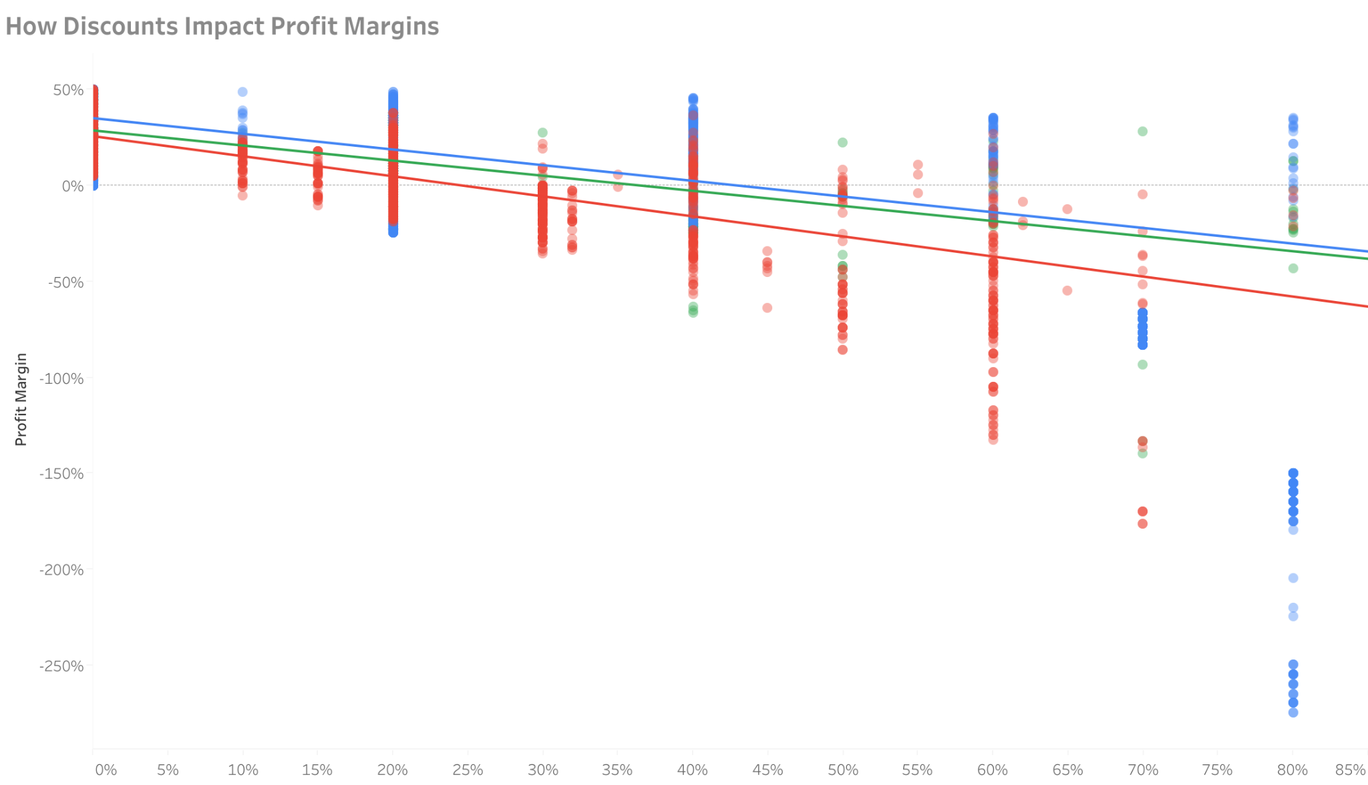
Impact of Discounts on Profit Margins
There is a clear negative relationship between discounts and profit margin
As discount levels increase, profit margins consistently decrease
High discount levels frequently result in negative profit margins
Furniture shows the steepest decline, indicating higher sensitivity to discounting

Slide 8
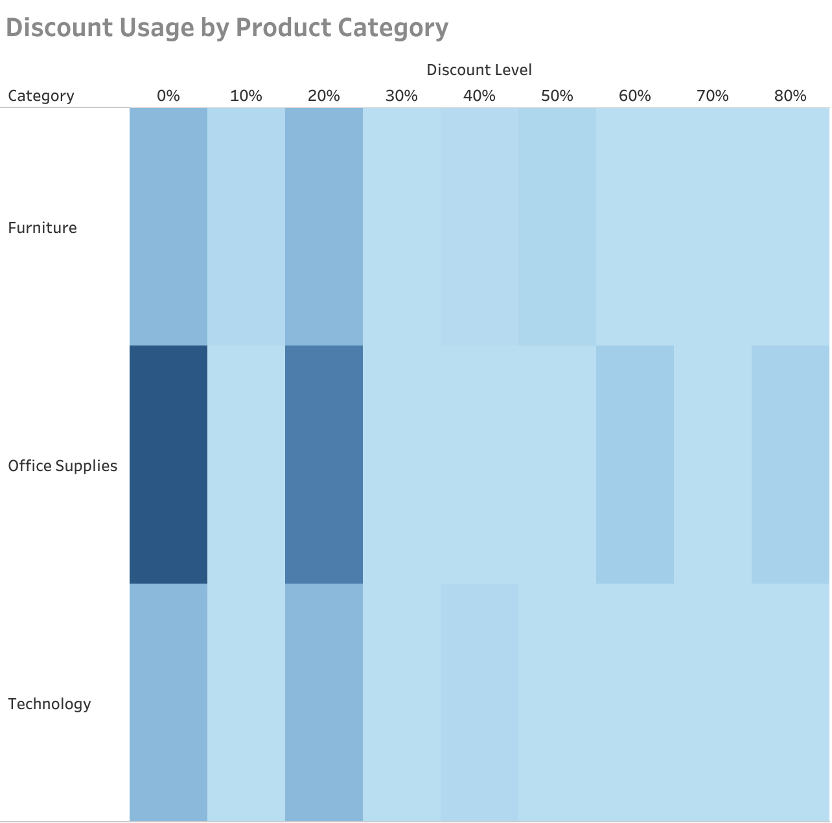
Discount Usage by Product Category
Discounting is widely used across all product categories
Office Supplies shows the highest concentration of low-to-mid discounts
Higher discount levels are used less frequently but still present across categories
• Discounting behaviour is consistent across categories, not isolated to one segment

Slide 9
Key Insights
Sales have grown steadily over time, but profitability has not followed at the same rate
Higher sales do not always translate into higher profit, indicating margin pressure
Discounting has a clear negative impact on profit margins across all categories
Furniture is the most affected category, showing the steepest decline in profitability with increased discounting
Discounting is widely used across the business, suggesting a systemic reliance on price reductions

Slide 10
Recommendations
Reduce high discount levels, particularly in categories with low profit margins
Review pricing and cost structures in Furniture to improve profitability
Focus on growing high-performing categories such as Technology
Implement stricter monitoring of profit margins alongside sales performance
Test alternative strategies (e.g. targeted promotions) instead of broad discounting

Slide 11
Appendix
Data Source
Superstore retail dataset (2014–2017)
Tools Used
Python (data exploration & analysis)
Tableau Public (data visualisation & dashboarding)
Key Notes
Profit Margin calculated as Profit ÷ Sales
Each row represents a single order
Discount values represent % reductions applied per order
Project Links
Tableau Dashboard: https://public.tableau.com/views/RetailE-CommercePerformance/RetailPerformanceOverview
GitHub Repository: [insert link]

